Slide 1
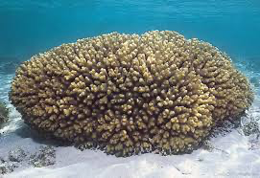
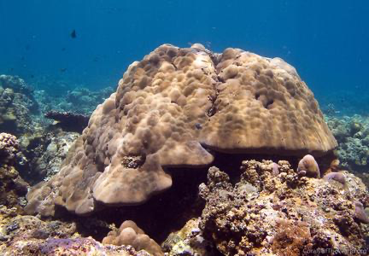
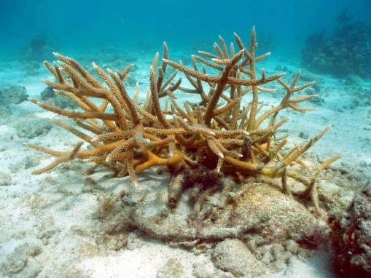
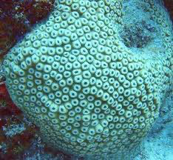
Ask Cassie/Taylor/Francois for good pics of each species
Ask Hollie/Ariana/Francois for good pics of each species
a)
Florida
b)
Hawai’i
Dates: May 23 – June 9, 2016
Dates: June 8 – June 15, 2015
Montipora capitata
Intermediate
Pocillopora acuta
Branching
Porites lobata
Massive
Acropora cervicornis
Branching
Montastrea cavernosa
Massive
Orbicella faveolata
Massive
Mcap
Ofav
Control (0 mg/L)
Control (0 mg/L)
Treatment 1 (30 mg/L)
Mid (150 mg/L)
Treatment 2 (100 mg/L)
High (235 mg/L)
Treatment 3 (300 mg/L)
Treatment 4 (1000 mg/L)
Day 0
Day 18
Day 0
Day 4
Day 7
Notes:
Figure 1: Experimental design for the Florida and Hawai’I sediment exposures. (a) Acropora cervicornis, Montastrea cavernosa, and Orbicella faveolata were exposed to varying levels of sterilized XXXXXXX sediment. There were 3XXX replicate tanks per treatment and XXXXXnumber of each species in each treatment. Sediment was added XXXXX. On Day 18, fragments from all treatments were XXXX for molecular analysis. (b) Montipora capitata, Pocillopora acuta, and Porites lobata were exposed to varying levels of unsterilizied XXXXX sediment. There were 2XXXX replicate tanks per treatment and XXXXXnumber of each species in each treatment. Sediment was added XXXXX days. On Day 4 and Day 7 of the exposures, XXXX fragments were XXXXX frozen for molecular analysis.

Slide 2
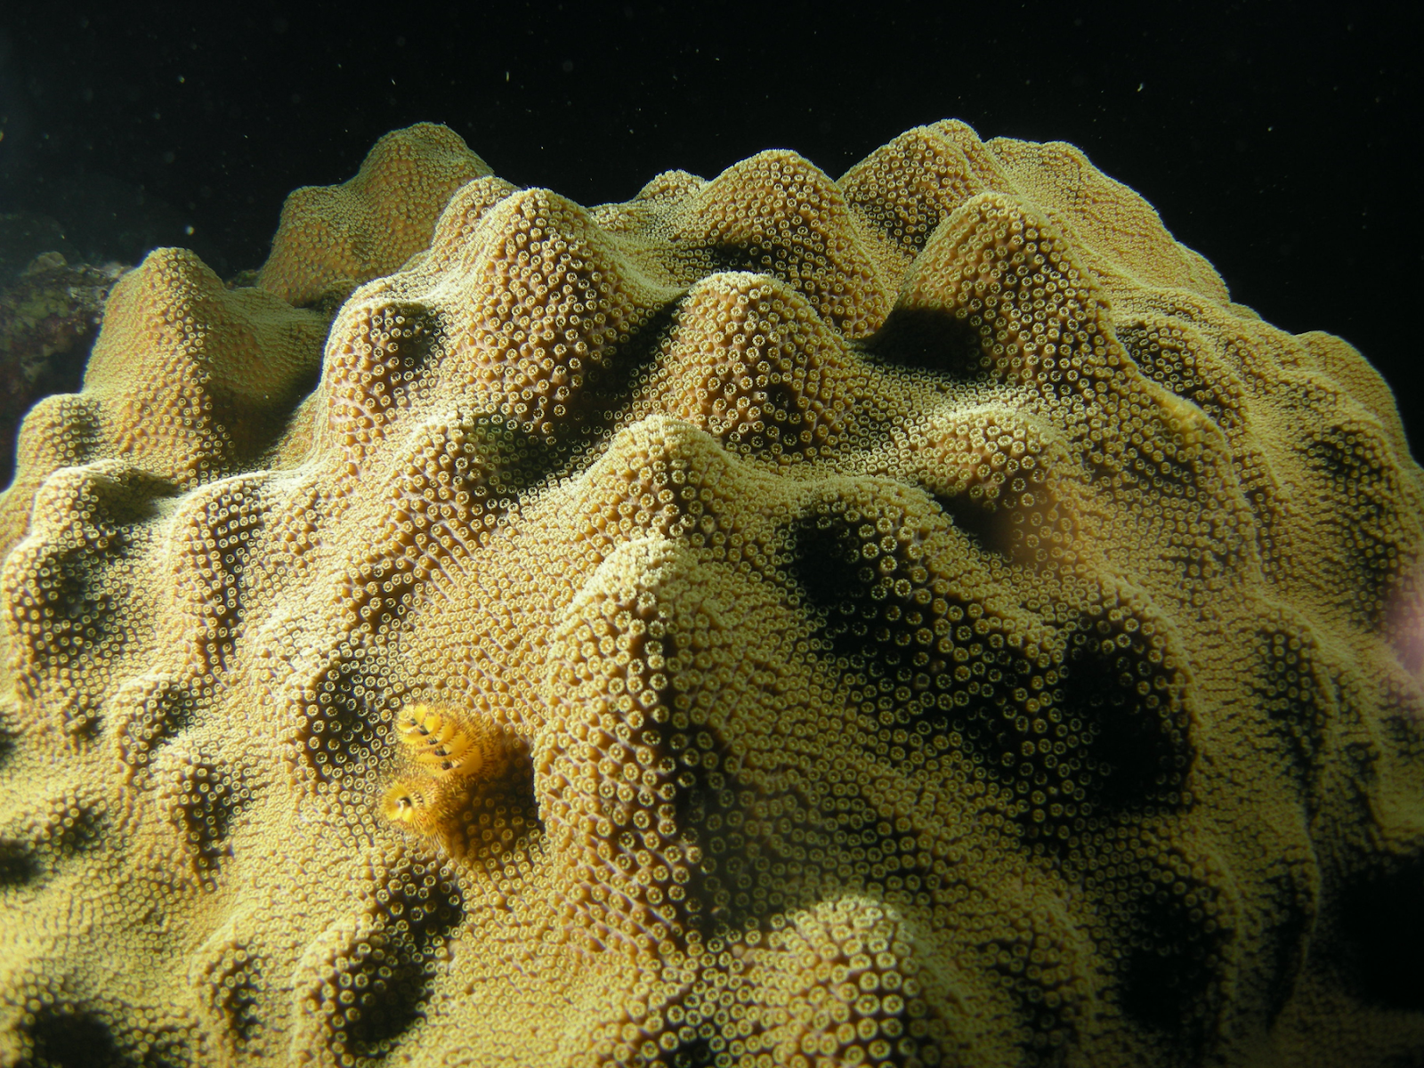
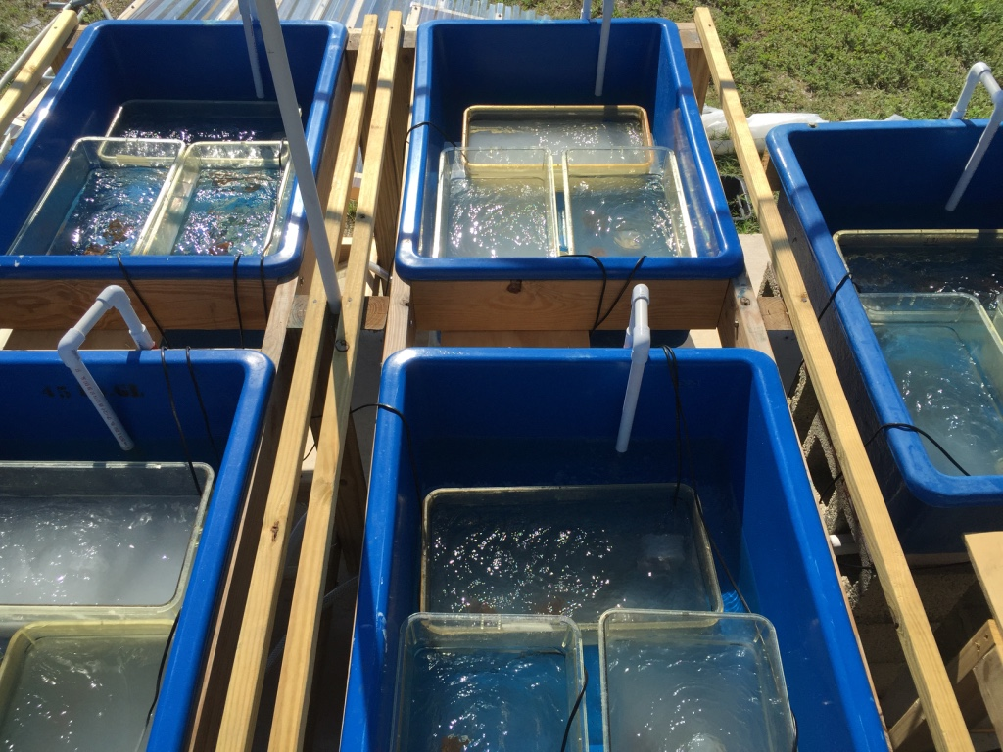
Florida
a)
Dates: May 23 – June 9, 2016
Acropora cervicornis
Branching
Montastrea cavernosa
Massive
Orbicella faveolata
Massive
Control (0 mg/L)
Treatment 1 (30 mg/L)
Treatment 2 (100 mg/L)
Treatment 3 (300 mg/L)
Treatment 4 (1000 mg/L)
Day 0
Day 0
Day 18
Notes:
Figure 1: Experimental design for the Florida and Hawai’I sediment exposures. (a) Acropora cervicornis, Montastrea cavernosa, and Orbicella faveolata were exposed to varying levels of sterilized XXXXXXX sediment. There were 3XXX replicate tanks per treatment and XXXXXnumber of each species in each treatment. Sediment was added XXXXX. On Day 18, fragments from all treatments were XXXX for molecular analysis. (b) Montipora capitata, Pocillopora acuta, and Porites lobata were exposed to varying levels of unsterilizied XXXXX sediment. There were 2XXXX replicate tanks per treatment and XXXXXnumber of each species in each treatment. Sediment was added XXXXX days. On Day 4 and Day 7 of the exposures, XXXX fragments were XXXXX frozen for molecular analysis.

Slide 3
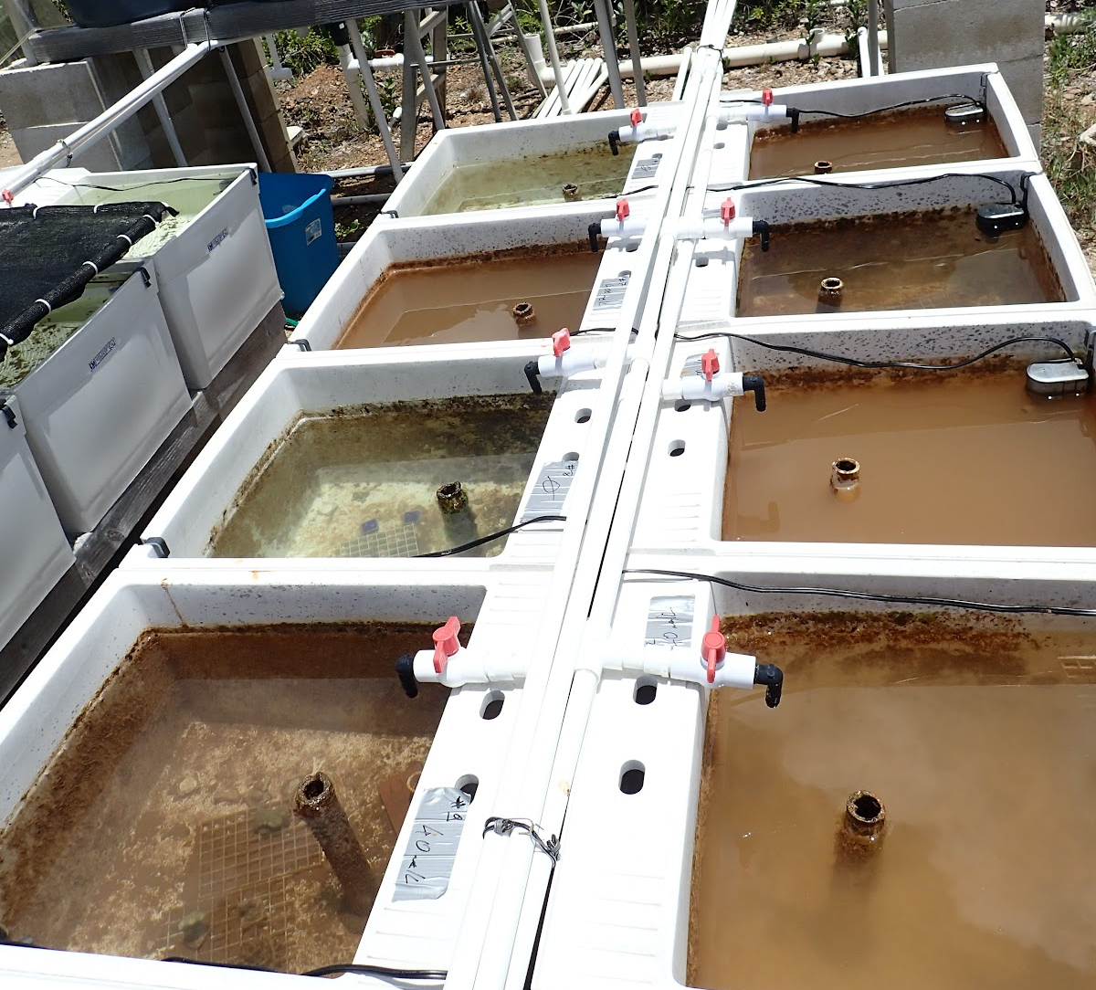
Hawai’i
b)
Dates: June 8 – June 15, 2015
Montipora capitata
Intermediate
Pocillopora acuta
Branching
Porites lobata
Massive
Mcap
Control (0 mg/L)
Mid (150 mg/L)
High (235 mg/L)
Day 0
Day 4
Day 7
Notes:
Figure 1: Experimental design for the Florida and Hawai’I sediment exposures. (a) Acropora cervicornis, Montastrea cavernosa, and Orbicella faveolata were exposed to varying levels of sterilized XXXXXXX sediment. There were 3XXX replicate tanks per treatment and XXXXXnumber of each species in each treatment. Sediment was added XXXXX. On Day 18, fragments from all treatments were XXXX for molecular analysis. (b) Montipora capitata, Pocillopora acuta, and Porites lobata were exposed to varying levels of unsterilizied XXXXX sediment. There were 2XXXX replicate tanks per treatment and XXXXXnumber of each species in each treatment. Sediment was added XXXXX days. On Day 4 and Day 7 of the exposures, XXXX fragments were XXXXX frozen for molecular analysis.

Slide 4
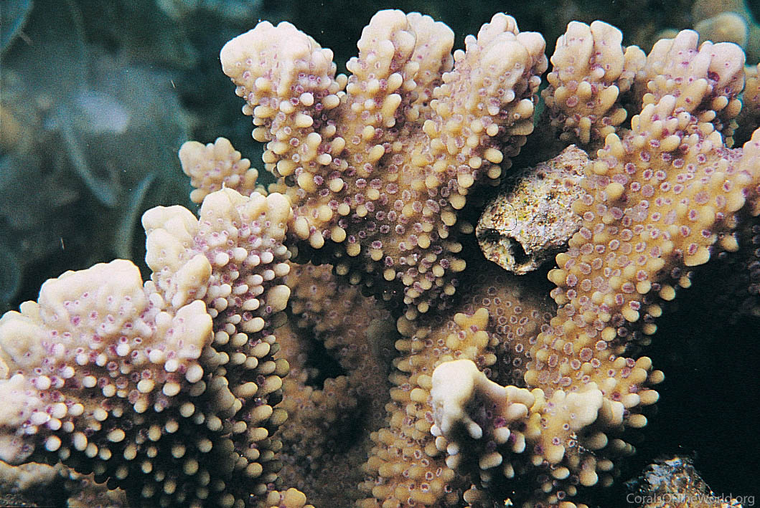
Species
Treatments & experiment duration
Experimental set-up
Day 0
Day 18
Florida
Treatment 1 (30 mg/L)
Treatment 2 (100 mg/L)
Treatment 3 (300 mg/L)
Treatment 4 (1000 mg/L)
Day 0
Day 4
Day 7
Hawai’i
Control (0 mg/L)
Mid (150 mg/L)
High (235 mg/L)

Slide 5
Species
Treatments & experiment duration
Experimental set-up
Acropora cervicornis (right)
Branching
Dates: 5/25/2016 – 6/23/2016
Day 0
Day 18
Florida
Treatment 1 (30 mg/L)
Treatment 2 (100 mg/L)
Montestrea cavernosa (above)
Massive
Treatment 3 (300 mg/L)
Treatment 4 (1000 mg/L)
Orbicella faveolata (right)
Massive
Montipora capitata (right)
Intermediate
Dates: 6/8/2015 – 6/15/2015
Day 0
Day 4
Day 7
Hawai’i
Control (0 mg/L)
Mid (150 mg/L)
Pocillopora acuta (above)
Branching
High (235 mg/L)
Porites lobata (right)
Massive

